Slide 1


Data Analytics using R Programming

Slide 2


Slide 3
Data Analytics
Data Science and Data Analytics are two most trending terminologies of today’s time.
Data is collected into raw form and processed according to the requirement of a company.
This data is utilized for the decision making purpose.
This process helps the businesses to grow in the market.
But, the main question arises – What is the process called?
Data Analytics is the answer here. and, Data Analyst and Data Scientist are the ones who perform this process.

Slide 4
What is Data Analytics?
Data or information is in raw format.
The increase in size of the data has led to arise
In need for carrying out inspection, data cleaning and transformation.
Data modeling to gain insights from the data in order to derive conclusions for better decision-making process.
This process is known as data analysis.
The analysis is an interactive process of a person tackling a problem, finding the data required to get an answer, analyzing that data, and interpreting the results in order to provide a recommendation for action.

Slide 5
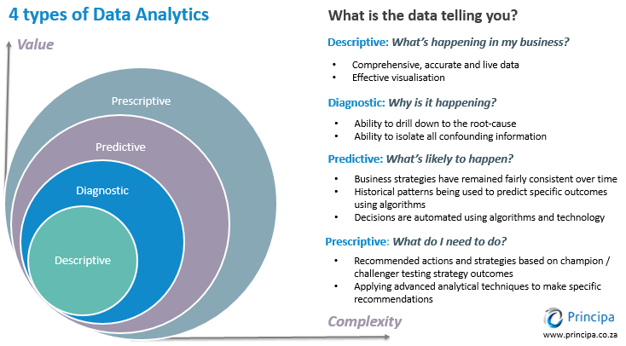
https://www.kdnuggets.com/2017/07/4-types-data-analytics.html

Slide 6

Descriptive:
What is happening?
The help of descriptive analysis, we analyze and describe the features of a data.
It deals with the summarization of information.
In the descriptive analysis, we deal with the past data to draw conclusions and present our data in the form of actionable results.

Slide 7

2. Diagnostic:
Why is it happening?
Diagnostic analytics is a form of advanced analytics that examines data or content to answer the question,
It is characterized by techniques such as data discovery, data mining and correlations.

Slide 8

3. Predictive: What is likely to happen?
With the help of predictive analysis, determine the future outcome.
Based on the analysis of the historical data, we are able to forecast the future.
With the help of data analytics, technological advancements and machine learning, we are able to obtain predictive about the future effectively.
Predictive analytics is a complex field that requires a large amount of data, skilled implementation of predictive models.
Its tuning to obtain accurate predictions.

Slide 9

4. Prescriptive:
What do I need to do?
Understanding of
what has happened,
why it has happened.
variety of “what-might-happen” analysis.
help the user determine the best solutions of action to take.
Prescriptive analysis is typically not just with one individual action but is in fact a host of other actions.
Best route home and considering the distance of each route, the speed

Slide 10
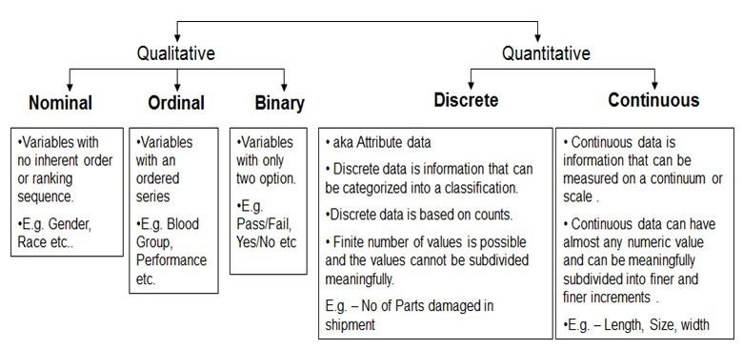
What is the types of Data in Data Analytics

Slide 12
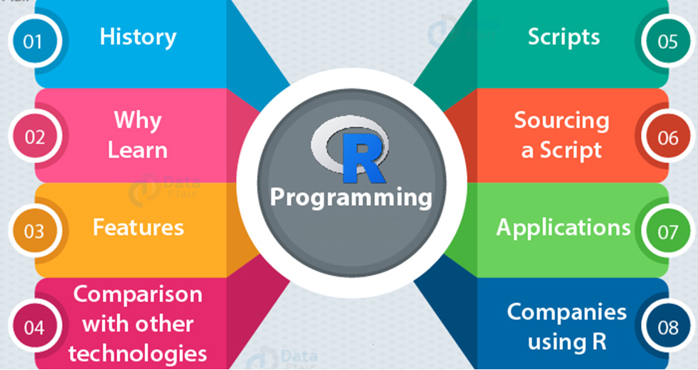
History

Slide 13

History
R is a programming language and software environment for statistical analysis, graphics representation and reporting.
R was created by Ross Ihaka and Robert Gentleman at the University of Auckland, New Zealand.
R is freely available under the GNU General Public License.
R provided for various operating systems like Linux, Windows and Mac.
This programming language was named R, based on the first letter of first name of the two R authors (Robert Gentleman and Ross Ihaka).

Slide 14
R play on the name of the Bell Labs Language S.
R was initially written at the Department of Statistics of the University of Auckland in Auckland, New Zealand.
R made its first appearance in 1993.
Since mid-1997 there has been a core group (the "R Core Team") who can modify the R source code archive.

Slide 15
Why Learn R Programming Language
With R, you can perform statistical analysis, data analysis as well as machine learning.
We can create objects, functions and packages in it.
R is platform-independent and can be used across multiple operating systems.
R is free owing to its open-source GNU licensing and can be installed by anyone.
R consists of a robust collection of graphical libraries like ggplot2, plotly and many more.
R is most widely used by the various industries like health, finance, banking, manufacturing and many more.
There are about 2 million job openings for R programmers worldwide.
Companies hire R programmers for many roles like data analysts, business analysts, data visualization experts, and business intelligence experts.

Slide 16
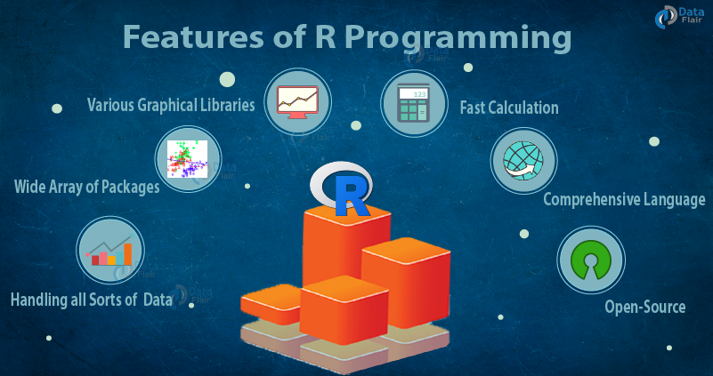

Slide 17
Features of R
As stated earlier, R is a programming language and software environment for statistical analysis, graphics representation and reporting. The following are the important features of R −
R is a well-developed, simple and effective programming language which includes conditionals, loops, user defined recursive functions and input and output facilities.
R has an effective data handling and storage facility,
R provides a suite of operators for calculations on arrays, lists, vectors and matrices.
R provides a large, coherent and integrated collection of tools for data analysis.

Slide 18
How R is better than Other Technologies
There are certain unique aspects of R programming which makes it better in comparison with other technologies:
Graphical Libraries – Libraries like ggplot2, plotly facilitate appealing libraries for making well-defined plots.
Availability / Cost – R is completely free.
Advancement in Tool – R supports various advanced tools and features that allow you to build robust statistical models.
Job Scenario – The immense growth in Data Science and rise in demand, R has become the most in-demand programming language of the world today.
Customer Service Support and Community – With R, you can enjoy strong community support.
Portability – R is highly portable. Many different programming languages and software frameworks can easily combine with the R environment for the best results.

Slide 19
Sourcing of R Script
RStudio
RStudio is an Integrated Development Environment for R.
It facilitates extensive code editing, development as well as various features.
Features of RStudio
RStudio provides various tools and features that allow you to boost your code productivity.
It can also be accessed over the web and is cross-platform in nature.
It facilitates automatic checking of updates
It provides support for recovery in case of file loss.
With RStudio, you can manage the data more efficiently.

Slide 20
Components of RStudio
Source – In the top left corner of the screen is the text editor that allows you to work within source scripting. You can enter multiple lines in this source.
Console – This is present on the bottom left corner of the main window of R Studio. It facilitates interactive scripting in R.
Workspace and History – In the top right corner, the R workspace and the history window. This will give you the list of all the variables and view the list of past commands that were executed by R.

Slide 21
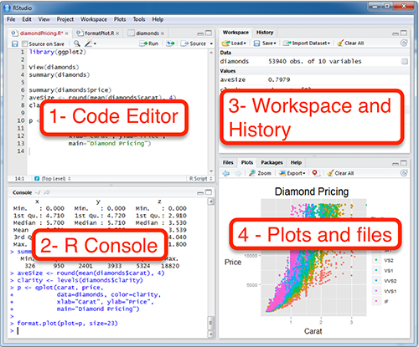

Slide 22
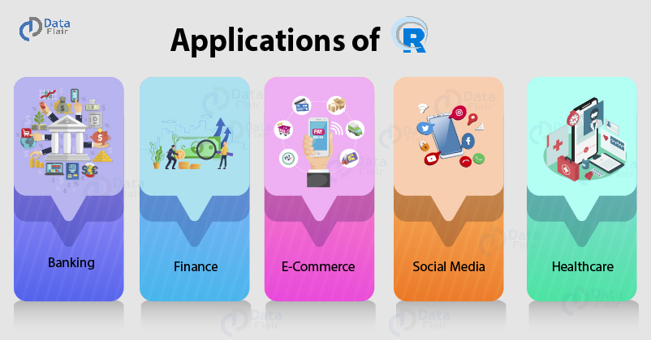

Slide 23
Applications of R Programming
finance and banking sectors for detecting fraud, reducing customer churn rate and for making future decisions.
bioinformatics to analyze strands of genetic sequences, for performing drug discovery and also in computational neuroscience.
Social media analysis to discover potential customers in online advertising.
Companies also use social media information to analyze customer sentiments for making their products better.
E-Commerce companies make use of R to analyze the purchases made by the customers as well as their feedbacks.
Manufacturing companies use R to analyze customer feedback.
They also use it to predict future demand to adjust their manufacturing speeds and maximize profits.

Slide 24
Companies Using R
Some of the companies that are using R programming are as follows:
Facebook
Google
Linkedin
IBM
Twitter
Uber
Airbnb
Ford Motor company
Microsoft

Slide 25
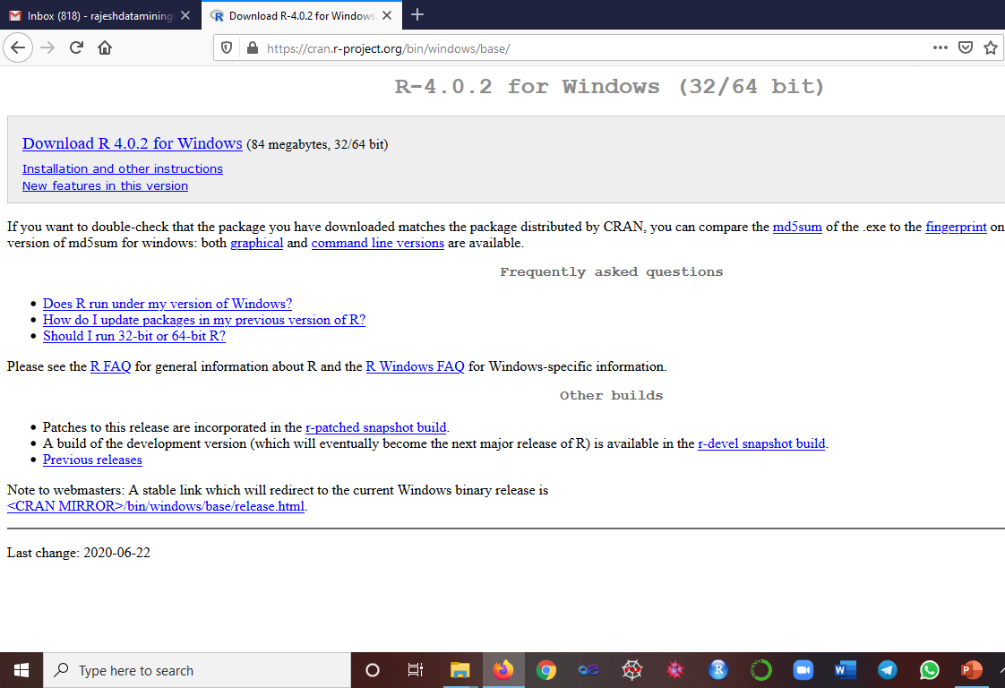
R Installation
https://cran.r-project.org/bin/windows/base/

Slide 26
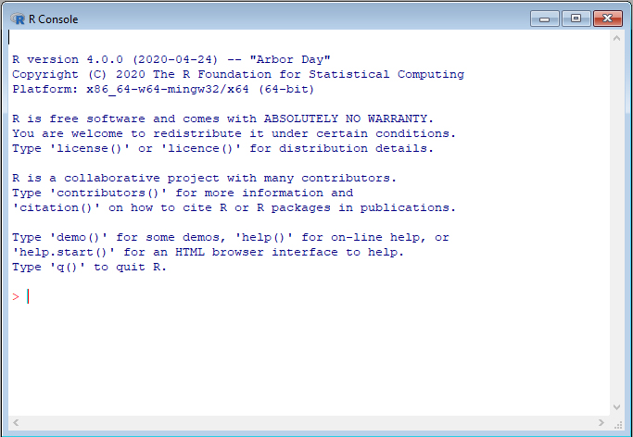
R Console Window

Slide 27
R Command Prompt
Once you have R environment setup, then it’s easy to start your R command prompt by just typing the following command.
This will launch R interpreter and you will get a prompt > where you can start typing your program as follows.
> myString <- "Hello, World!"
> print ( myString)
[1] "Hello, World!"

Slide 28
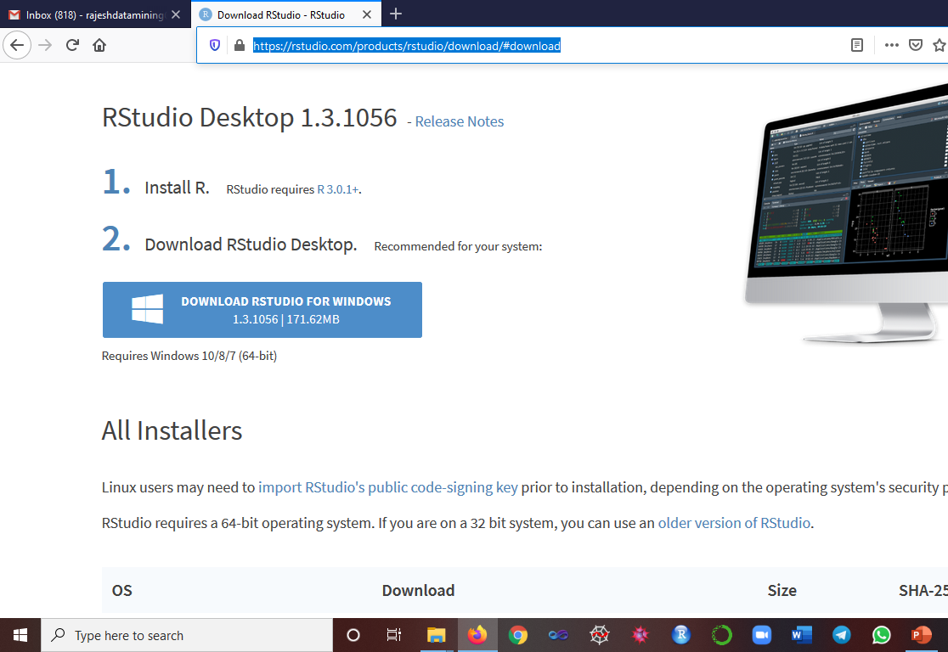
Rstudio (IDE)
https://rstudio.com/products/rstudio/download/#download

Slide 29
R - Data Types
In contrast to other programming languages like C and java in R, the variables are not declared as some data type.
The variables are assigned with R-Objects and the data type of the R-object becomes the data type of the variable.
There are many types of R-objects. The frequently used ones are −
Vectors
Lists
Matrices
Arrays
Factors
Data Frames

Slide 30
R - Functions
A function is a set of statements to perform a specific task.
R has a large number of in-built functions
The user can create their own functions.
Built-in Function
Simple examples of in-built functions are seq(), mean(), max(), sum(x) and paste(...) etc.
They are directly called by user written programs.
# Create a sequence of numbers from 32 to 44.
print(seq(32,44))
# Find mean of numbers from 25 to 82.
print(mean(25:82))
# Find sum of numbers from 41 to 68.
print(sum(41:68))

Slide 31
User-defined Function
They are specific to what a user wants and once created they can be used like the built-in functions.
# Create a function to print squares of numbers in sequence. new.function <- function(a) { for(i in 1:a) { b <- i^2 print(b) } }
Calling a Function
# Call the function new.function supplying 6 as an argument. new.function(6)
Produces the following result −
[1] 1 [1] 4 [1] 9 [1] 16 [1] 25 [1] 36

Slide 32
R String Manipulation Functions
1. grep()
It is used for pattern matching and replacement.
grep("b+", c("abc", "bda", "ccaa", "abd"), perl=TRUE, value=TRUE)
grep("b+", c("abc", "bda", "ccaa", "abd"), perl=TRUE, value=FALSE)
grep("chid+", c("chidambaram", "Villupuram", "Srimushnam", "chidambaram"), perl=TRUE, value=FALSE)
grep("அ+", c("அப்பா", "தாத்தா", "அம்மா"), perl=TRUE, value=FALSE)
[1] 1 2 4
[1] 1 4
[1] 1 3

Slide 33
2. nchar()
With the help of this function, we can count the characters.
> str <- "Big Data at DataFlair"
> nchar(str)
[21]
3. paste()
Concatenate n number of strings using the paste() function.
> #Author DataFlair
> paste("Hadoop", "Spark", "and", "Flink")
[1] “Hadoop, Spark, and, Flink”
4. sprintf()
This function makes of the formatting commands that are styled after C.
> sprintf("%s scored %.2f percent", "Matthew", 72.3)
> [1] Matthew scored 72.30 percent

Slide 34
5. strsplit()
> #Author DataFlair
> str = "Splitting sentence into words"
> strsplit(str, " ")
> strsplit(str, "")
Output
[1] "Splitting" "sentence" "into" "words"
[1] "S" "p" "l" "i" "t" "t" "i" "n" "g" " " "s" "e" "n" "t" "e" "n" "c" "e" " " "i" "n" "t" "o" " " "w" "o" "r" "d" "s"

Slide 35
Vector
Vectors are the most basic R data objects and there are six types of atomic vectors. They are logical, integer, double, complex, character and raw.
Multiple Elements Vector - Using colon operator with numeric data
# Creating a sequence from 5 to 13.
v <- 5:13
print(v)
[1] 5 6 7 8 9 10 11 12 13
# Creating a sequence from 6.6 to 12.6.
v <- 6.6:12.6
print(v)
[1] 6.6 7.6 8.6 9.6 10.6 11.6 12.6
# If the final element specified does not belong to the sequence then it is discarded.
v <- 3.8:11.4
print(v)
[1] 3.8 4.8 5.8 6.8 7.8 8.8 9.8 10.8

Slide 36
Using sequence (Seq.) operator
# Create vector with elements from 5 to 9 incrementing by 0.4.
print(seq(5, 9, by = 0.4))
[1] 5.0 5.4 5.8 6.2 6.6 7.0 7.4 7.8 8.2 8.6 9.0
Using the c() function
The non-character values are coerced to character type if one of the elements is a character.
# The logical and numeric values are converted to characters.
s <- c('apple','red',5,TRUE)
print(s)
[1] "apple" "red" "5" "TRUE"

Slide 37
Accessing Vector Elements
The [ ] brackets are used for indexing. Indexing starts with position 1.
Giving a negative value in the index drops that element from result.
TRUE, FALSE or 0 and 1 can also be used for indexing.
# Accessing vector elements using position.
t <- c("Sun","Mon","Tue","Wed","Thurs","Fri","Sat")
u <- t[c(2,3,6)]
print(u) [1] "Mon" "Tue" "Fri"
# Accessing vector elements using logical indexing.
v <- t[c(TRUE,FALSE,FALSE,FALSE,FALSE,TRUE,FALSE)]
print(v) [1] "Sun" "Fri"
# Accessing vector elements using negative indexing.
x <- t[c(-2,-5)]
print(x) [1] "Sun" "Tue" "Wed" "Fri" "Sat"
# Accessing vector elements using 0/1 indexing.
y <- t[c(0,0,0,0,0,0,1)]
print(y) [1] "Sun"

Slide 38
R - Lists
Lists are the R objects which contain elements of different types.
numbers, strings, vectors and another list inside it.
List is created using list() function.
Creating a List
# Create a list containing strings, numbers, vectors and a logical values.
list_data <- list("Red", "Green", c(21,32,11), TRUE, 51.23, 119.1)
print(list_data)
[1] "Red"
[1] "Green"
[1] 21 32 11
[1] TRUE
[1] 51.23
[1] 119.1

Slide 39
R - Matrices
Matrices are the R objects in which the elements are arranged in a dimensional.
Syntax
matrix(data, nrow, ncol, byrow, dimnames)
data is the input vector which becomes the data elements of the matrix.
nrow is the number of rows to be created.
ncol is the number of columns to be created.
byrow, If TRUE, then the input vector elements are arranged by row.
dimname is the names assigned to the rows and columns.

Slide 40
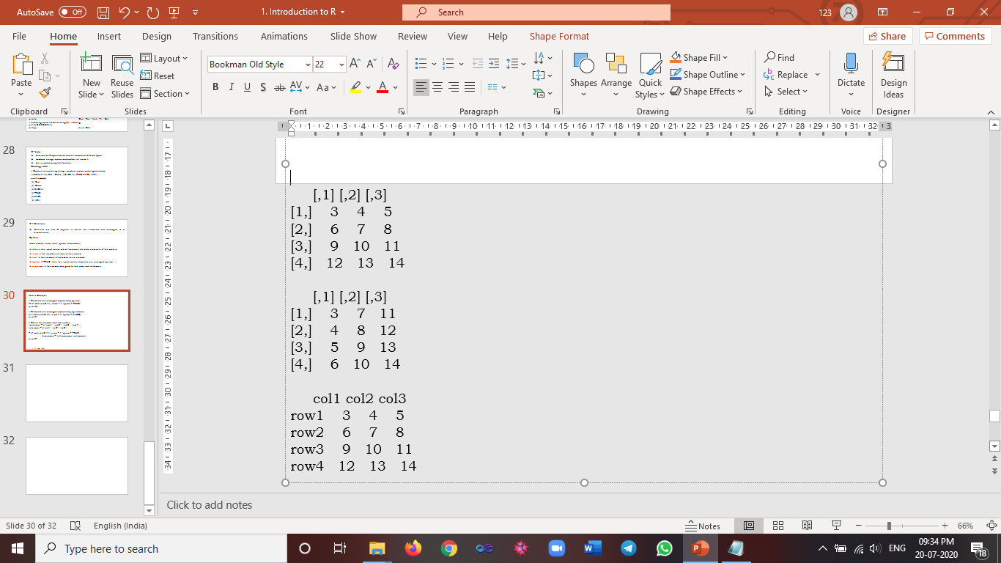
Matrix Example
# Elements are arranged sequentially by row.
M <- matrix(c(3:14), nrow = 4, byrow = TRUE)
print(M)
# Elements are arranged sequentially by column.
N <- matrix(c(3:14), nrow = 4, byrow = FALSE)
print(N)
# Define the column and row names.
rownames = c("row1", "row2", "row3", "row4")
colnames = c("col1", "col2", "col3")
P <- matrix(c(3:14), nrow = 4, byrow = TRUE,
dimnames = list(rownames, colnames))
print(P)

Slide 41
Accessing Elements of a Matrix
Matrix can be accessed by using the column and row index
# Define the column and row names.
rownames = c("row1", "row2", "row3", "row4")
colnames = c("col1", "col2", "col3")
# Create the matrix.
P <- matrix(c(3:14), nrow = 4, byrow = TRUE, dimnames = list(rownames, colnames))
# Access the element at 3rd column and 1st row.
print(P[1,3]) [1] 5
# Access the element at 2nd column and 4th row.
print(P[4,2]) [1] 13
# Access only the 2nd row.
print(P[2,]) col1 col2 col3
6 7 8
# Access only the 3rd column.
print(P[,3]) row1 row2 row3 row4
5 8 11 14

Slide 42
# Example for Matrix function A <- matrix(c(1, 2, 3, 4, 5, 6, 7, 8, 9),3,3) B <- matrix(c(11, 12, 13, 14, 15, 16, 17, 18, 19),3,3) C <- matrix(c(21, 22, 23, 24, 25, 26, 27, 28, 29),3,3) # Check whether the variable A Matrix or not is.matrix(A) #Multiplication by a Scalar s<-3 s1<-A*s s1 # Matrix Addition Matadd<-A+B Matadd # Matrix Subtraction Matsub<-A-B Matsub | # Matrix Multiflication Matmul<-A*B Matmul # Matrix Transforce tm<-t(A) A tm #Computing Column & Row Sums sum(A) colSums(A) rowSums(A) #Computing Column & Row Means mean(A) colMeans(A) rowMeans(A) #Accessing the matrix element A A[2,2] A[2,2]<-33 A[3,2]+B[2,2]

Slide 43
R - Data Frames
A data frame is a table or structure.
Each column contains values of one variable.
Following are the characteristics of a data frame
The column names should be non-empty.
The row names should be unique.
The data stored in a data frame can be of numeric, factor or character.
Each column should contain same number of data items.

Slide 44
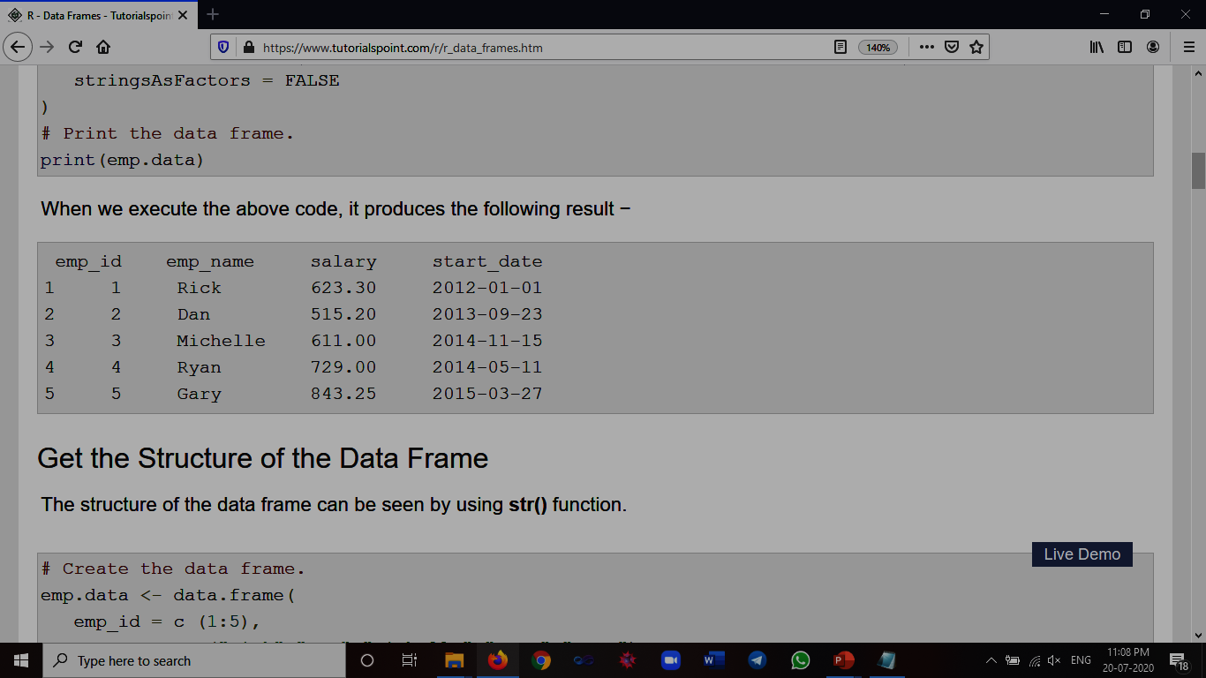
# Create the data frame.
emp.data <- data.frame( emp_id = c (1:5),
emp_name = c("Rick","Dan","Michelle","Ryan","Gary"),
salary = c(623.3,515.2,611.0,729.0,843.25),
start_date = as.Date(c("2012-01-01",
"2013-09-23", "2014-11-15",
"2014-05-11", "2015-03-27")),
stringsAsFactors = FALSE )
# Print the data frame.
print(emp.data)

Slide 45
Summary of Data in Data Frame
The statistical summary and nature of the data can be obtained by applying summary() function.
# Create the data frame.
emp.data <- data.frame( emp_id = c (1:5),
emp_name = c("Rick","Dan","Michelle","Ryan","Gary"),
salary = c(623.3,515.2,611.0,729.0,843.25),
start_date = as.Date(c("2012-01-01", "2013-09-23", "2014-11-15",
"2014-05-11", "2015-03-27")), stringsAsFactors = FALSE )
# Print the summary.
Print(emp.data)
print(summary(emp.data))

Slide 46
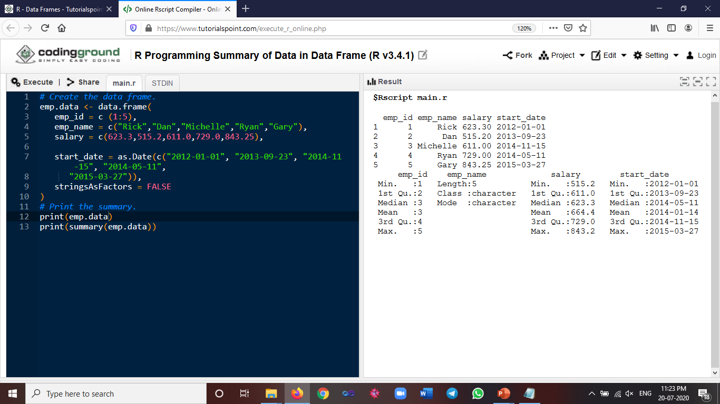
summary(emp.data)

Slide 47
Working with CSV Files
R read data from files stored outside the R environment.
Write data into files which will be stored and accessed by the operating system.
R can read and write into various file formats like csv, excel, xml etc.
Getting and Setting the Working Directory
getwd() - Find the working directory
setwd() - Set the working directory
# Get and print current working directory.
print(getwd())
# Set current working directory.
setwd("/web/com")
# Get and print current working directory.
print(getwd())

Slide 48
Input as CSV File
The csv file is a text file
The values in the columns are separated by a comma.
The following data present in the file named input.csv.
id,name,salary,start_date,dept
1,Rick,623.3,2012-01-01,IT
2,Dan,515.2,2013-09-23,Operations
3,Michelle,611,2014-11-15,IT
4,Ryan,729,2014-05-11,HR
5,Gary,843.25,2015-03-27,Finance
6,Nina,578,2013-05-21,IT
7,Simon,632.8,2013-07-30,Operations
8,Guru,722.5,2014-06-17,Finance

Slide 49
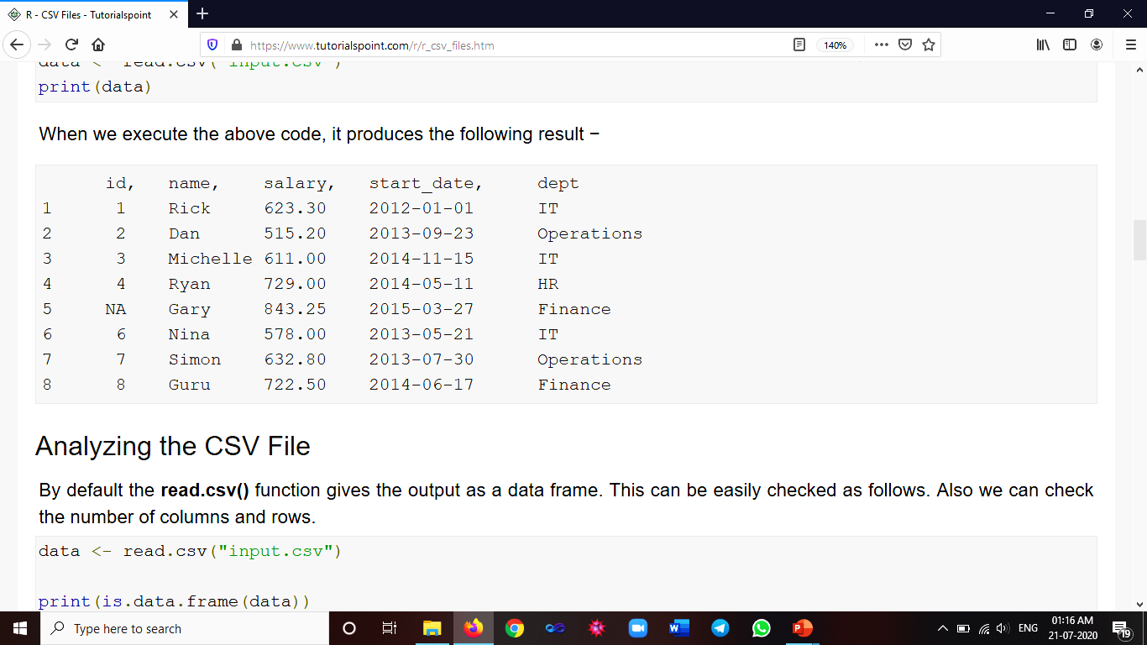
Reading a CSV File
read.csv()
function to read a CSV file available in your current working directory
data <- read.csv("input.csv")
print(data)
Output

Slide 50
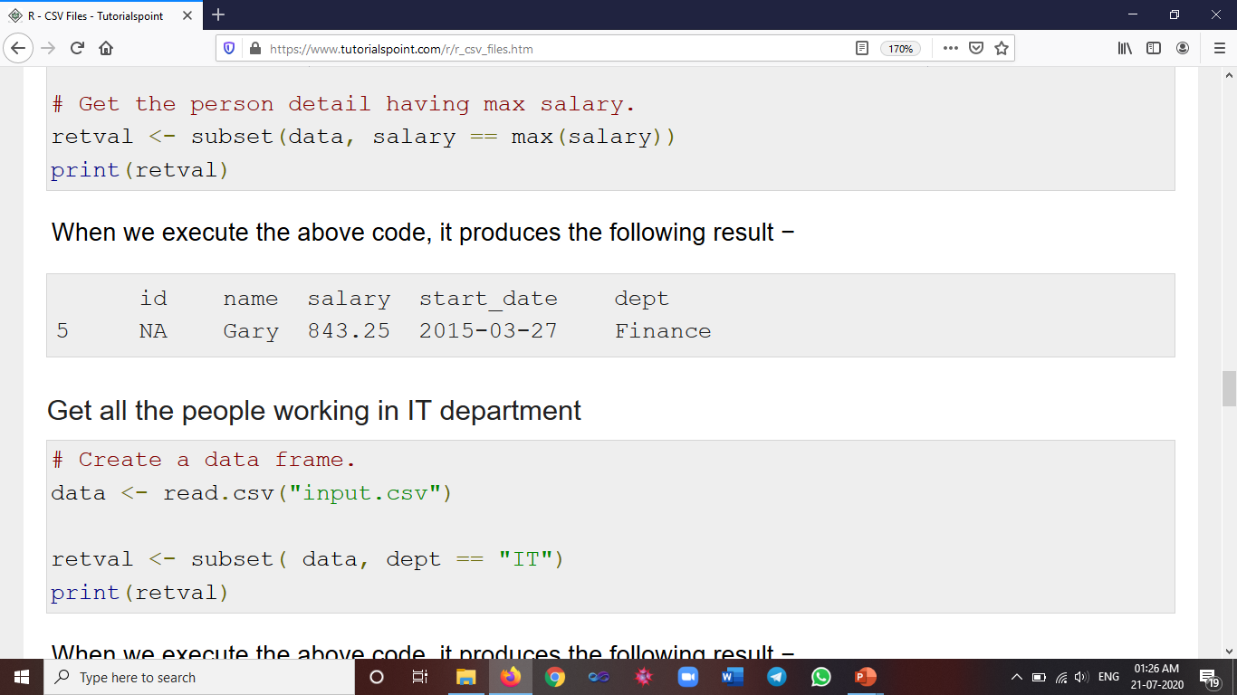
Analysing the CSV File
read.csv() function gives the output as a data frame
data <- read.csv("input.csv")
print(is.data.frame(data))
print(ncol(data))
print(nrow(data)) [1] TRUE [1] 5 [1] 8
Get the maximum salary
# Create a data frame.
data <- read.csv("input.csv")
# Get the max salary from data frame.
sal <- max(data$salary)
# Get the person detail having max salary.
retval <- subset(data, salary == max(salary))
print(retval)

Slide 51
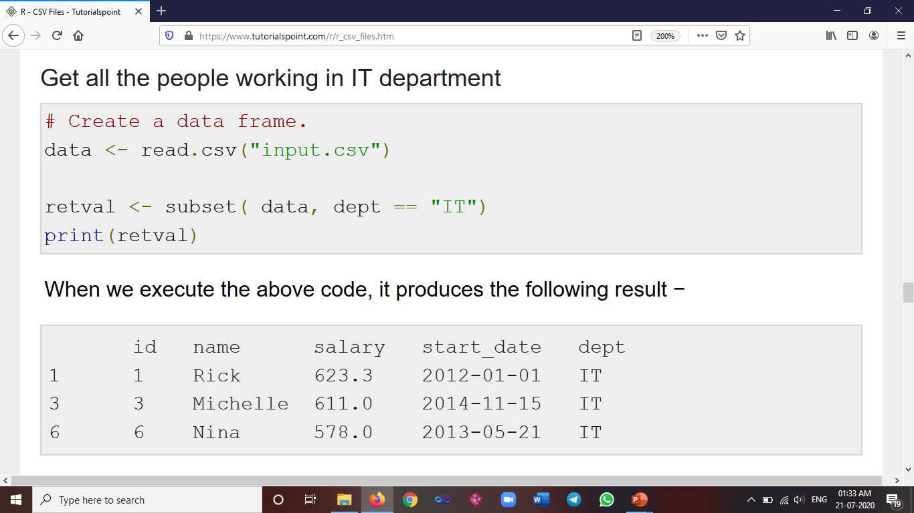

Slide 52
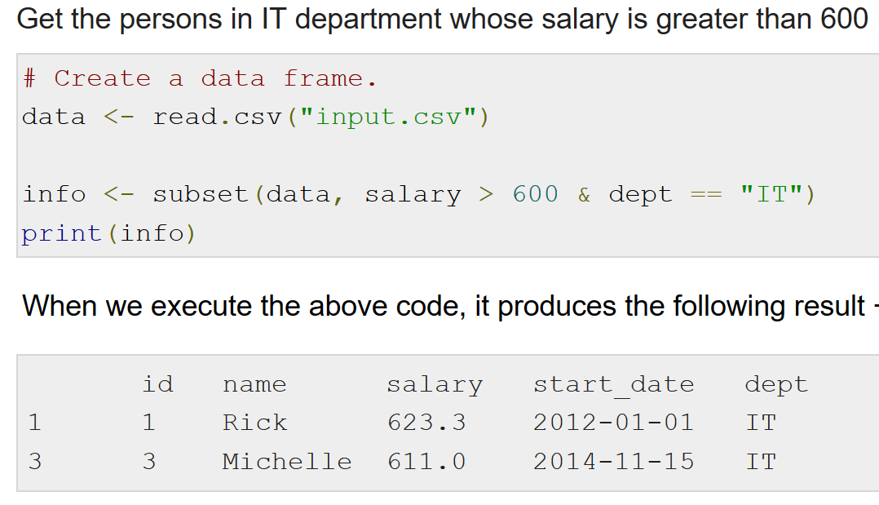

Slide 53
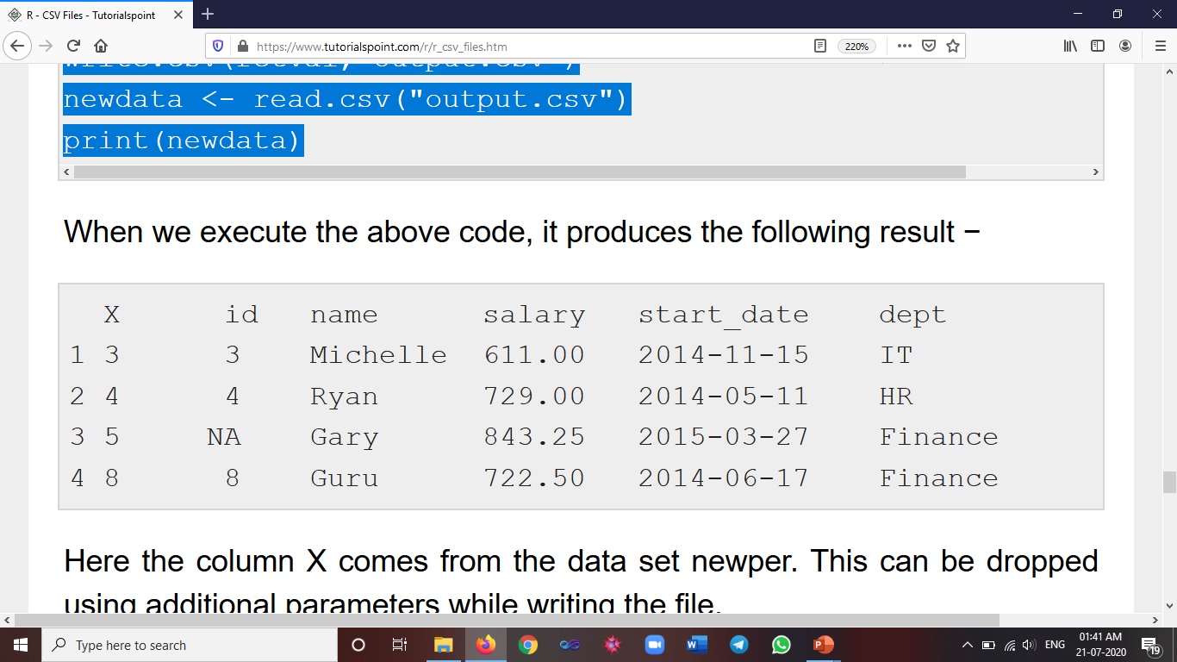
Writing into a CSV File
R can create csv file form using existing data frame.
The write.csv() function is used to create the csv file.
This file gets created in the working directory.
# Create a data frame.
data <- read.csv("input.csv")
retval <- subset(data, as.Date(start_date) > as.Date("2014-01-01"))
# Write filtered data into a new file.
write.csv(retval,"output.csv")
newdata <- read.csv("output.csv")
print(newdata)

Slide 54
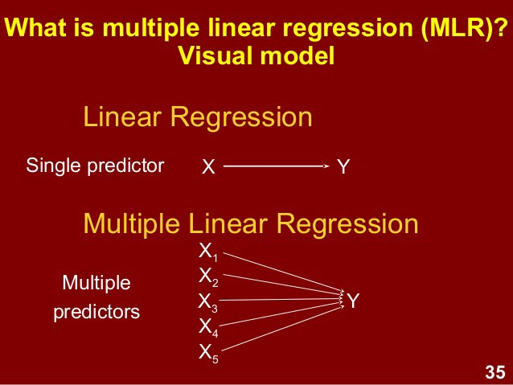

Slide 55
Linear Regression
Regression analysis is a very widely used statistical tool to establish a relationship model between two variables.
One of these variable is called predictor variable whose value is gathered through experiments.
The other variable is called response variable whose value is derived from the predictor variable.
Mathematically a linear relationship represents a straight line when plotted as a graph.
The general mathematical equation for a linear regression is y = ax + b
Following is the description of the parameters used −
y is the response variable.
x is the predictor variable.
a and b are constants which are called the coefficients.

Slide 56
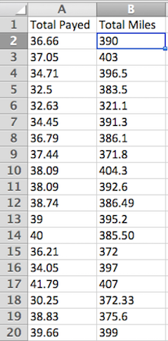
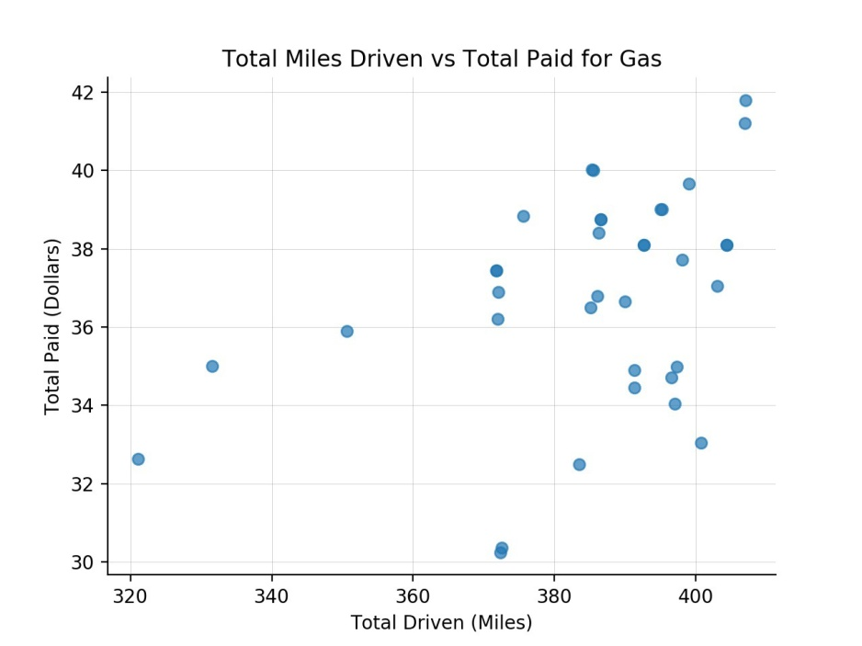
How much money should you allocate for gas?
You approach this problem with a science-oriented mindset, thinking that there must be a way to estimate the amount of money needed, based on the distance you're travelling.
At this point these are just numbers. It's not very easy to get any valuable information from this spreadsheet.
"If I drive for 1200 miles, how much will I pay for gas?"

Slide 57
Sl.No. | Total Miles (x) | Total Payed (y) | x*x | x*y
1 | 390 | 36.66 | 152100 | 14297.4
2 | 403 | 37.05 | 162409 | 14931.15
3 | 396.5 | 34.71 | 157212.25 | 13762.52
4 | 383.5 | 32.5 | 147072.25 | 12463.75
5 | 321.1 | 32.63 | 103105.21 | 10477.49
6 | 391.3 | 34.45 | 153115.69 | 13480.29
7 | 386.1 | 36.79 | 149073.21 | 14204.62
8 | 371.8 | 37.44 | 138235.24 | 13920.19
9 | 404.3 | 38.09 | 163458.49 | 15399.79
10 | 392.6 | 38.09 | 154134.76 | 14954.13
11 | 386.49 | 38.74 | 149374.5201 | 14972.62
12 | 395.2 | 39 | 156183.04 | 15412.8
13 | 385.5 | 40 | 148610.25 | 15420
14 | 372 | 36.21 | 138384 | 13470.12
15 | 397 | 34.05 | 157609 | 13517.85
16 | 407 | 41.79 | 165649 | 17008.53
17 | 372.33 | 30.25 | 138629.6289 | 11262.98
18 | 375.6 | 38.83 | 141075.36 | 14584.55
19 | 399 | 39.66 | 159201 | 15824.34
 | 7330.32 | 696.94 | 2834631.899 | 269365.1
y = ax + b

Slide 58
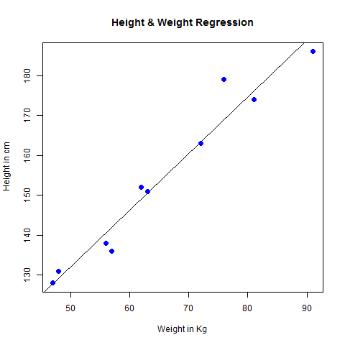
Visualize the Regression Graphically
# Create the predictor and response variable.
x <- c(151, 174, 138, 186, 128, 136, 179, 163, 152, 131)
y <- c(63, 81, 56, 91, 47, 57, 76, 72, 62, 48)
relation <- lm(y~x)
# Give the chart file a name.
png(file = "linearregression.png")
# Plot the chart.
plot(y,x,col = "blue",main = "Height & Weight Regression",abline(lm(x~y)),cex = 1.3,pch = 16,xlab = "Weight in Kg",ylab = "Height in cm")
# Save the file.
dev.off()

Slide 59
predict() Function
Predict the weight of new persons
# The predictor vector called Height
x <- c(151, 174, 138, 186, 128, 136, 179, 163, 152, 131)
# The response vector called Weight
y <- c(63, 81, 56, 91, 47, 57, 76, 72, 62, 48)
# Apply the lm() function
relation <- lm(y~x)
# Find weight of a person with height 170.
a <- data.frame(x = 170)
result <- predict(relation,a)
print(result)
When we execute the above code, it produces the following result −
1 76.22869

Slide 60
Multiple Regression
Multiple regression is an extension of linear regression into relationship between more than two variables.
In simple linear relation we have one predictor and one response variable.
But in multiple regression we have more than one predictor variable and one response variable.
The general mathematical equation for multiple regression is −
y = a + b₁x₁ + b₂x₂ +...b_{n}x_{n}
Following is the description of the parameters used −
y is the response variable.
a, b1, b2...bn are the coefficients.
x1, x2, ...xn are the predictor variables.
We create the regression model using the lm() function in R. The model determines the value of the coefficients using the input data.
Next we can predict the value of the response variable for a given set of predictor variables using these coefficients.

Slide 61
lm() Function
This function creates the relationship model between the predictor and the response variable.
Syntax
The basic syntax for lm() function in multiple regression is −
lm(y ~ x1+x2+x3...,data)
Following is the description of the parameters used −
formula is a symbol presenting the relation between the response variable and predictor variables.
data is the vector on which the formula will be applied.

Slide 62
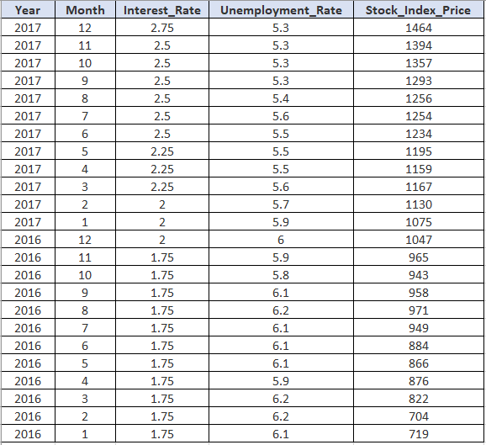
Unemployement Dataset

Slide 63
R Script Multiple Regression
# Capture the in R format
Year <- c(2017,2017,2017,2017,2017,2017,2017,2017,2017,2017,2017,2017,2016,2016,2016, 2016,2016,2016,2016,2016,2016,2016,2016,2016)
Month <- c(12, 11,10,9,8,7,6,5,4,3,2,1,12,11,10,9,8,7,6,5,4,3,2,1)
Interest_Rate <- c(2.75,2.5,2.5,2.5,2.5,2.5,2.5,2.25,2.25,2.25,2,2,2,1.75,1.75,1.75,1.75,1.75,1.75,1.75,1.75, 1.75,1.75,1.75)
Unemployment_Rate <- c(5.3,5.3,5.3,5.3,5.4,5.6,5.5,5.5,5.5,5.6,5.7,5.9,6,5.9,5.8,6.1,6.2,6.1,6.1,6.1,5.9,6.2,6.2,6.1)
Stock_Index_Price <- c(1464,1394,1357,1293,1256,1254,1234,1195,1159,1167,1130,1075,1047,965,943,958,971,949,884,866,876,822,704,719)

Slide 64
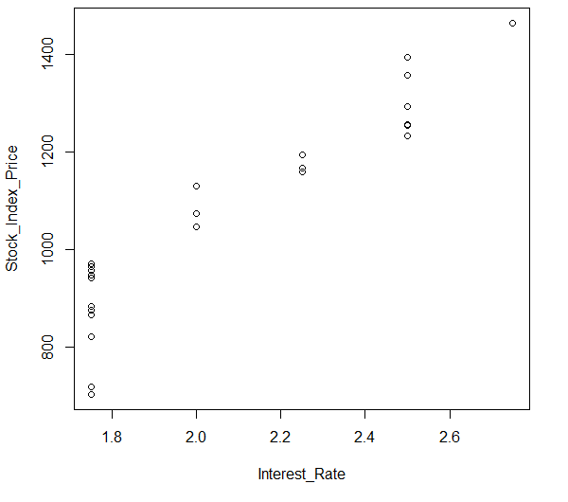
# Check the Linearity the corresponding data is correct or not
plot(x=Interest_Rate, y=Stock_Index_Price)

Slide 65
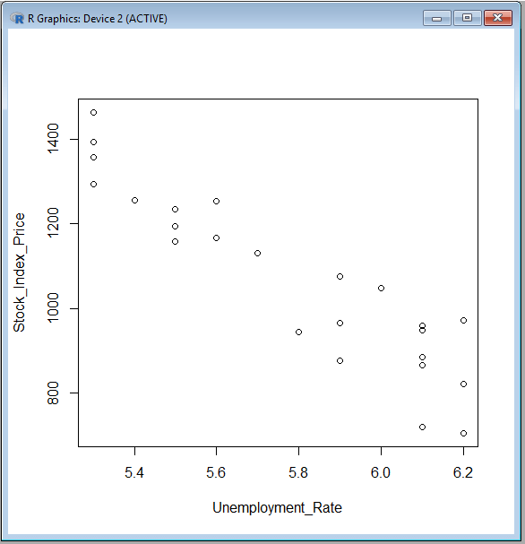
plot(x=Unemployment_Rate, y=Stock_Index_Price)

Slide 66
# Capture the in R format
student <- c(1,2,3,4,5,6,7,8,9,10)
testscore <- c(100,95,92,90,85,80,78,75,72,65)
IQ <- c(125,104,110,105,100,100,95,95,85,90)
studyhrs <- c(30,40,25,20,20,20,15,10,0,5)
# Check the Linearity the corresponding data is correct or not
plot(x=testscore, y=IQ)
plot(x=IQ, y=studyhrs)
#==================================================
# Predict Test Square using IQ and Study Hrs
relation <- lm(testscore ~ IQ + studyhrs)
a <- data.frame(IQ=120,studyhrs=40)
result <- predict(relation,a)
print(result)
#==================================================
# Predict IQ using Test Square and Study Hrs
relation <- lm(IQ ~ testscore + studyhrs)
a <- data.frame(testscore=50,studyhrs=25)
result <- predict(relation,a)
print(result)
#==================================================
# Predict IQ using Test Square and Study Hrs
relation <- lm(studyhrs ~ IQ + testscore )
a <- data.frame(IQ=140, testscore=90)
result <- predict(relation,a)
print(result)

Slide 67
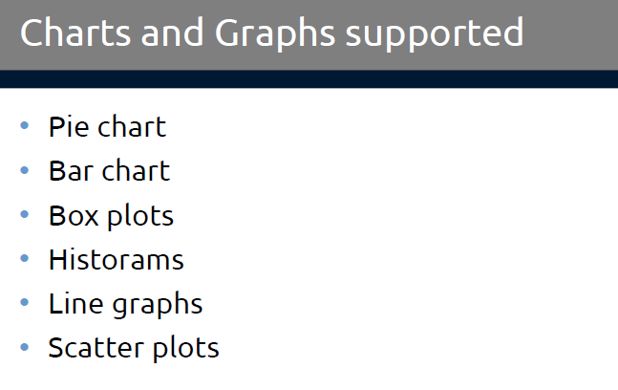

Slide 68
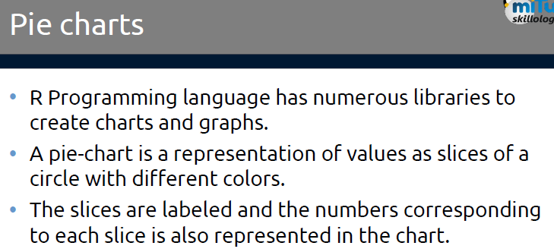

Slide 69
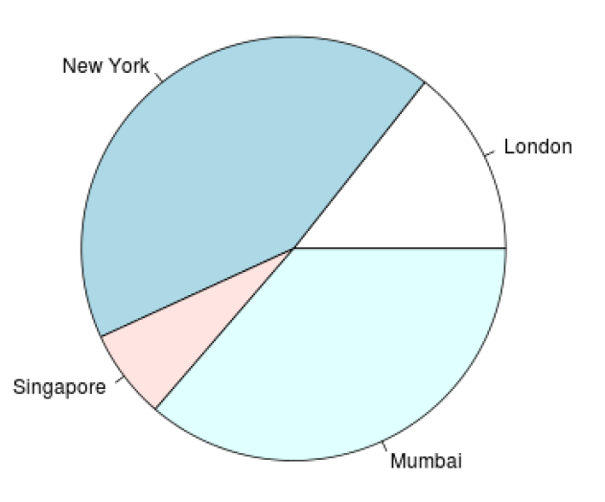
# Create data for the graph.
x <- c(21, 62, 10, 53)
labels <- c("London", "New York", "Singapore", "Mumbai")
# Give the chart file a name.
png(file = "city.png")
# Plot the chart.
pie(x,labels)
# Save the file.
dev.off()

Slide 70
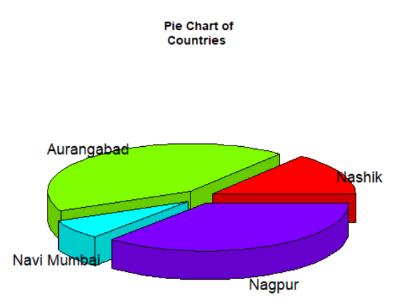
# Get the library.
library(plotrix)
# Create data for the graph.
x <- c(21, 62, 10,53)
lbl <- c("Nashik","Aurangabad","Navi Mumbai","Nagpur")
png(file = "3d_pie_chart.png")
# Plot the chart.
pie3D(x,labels = lbl,explode = 0.1, main = "Pie Chart of
Countries ")
dev.off()

Slide 71
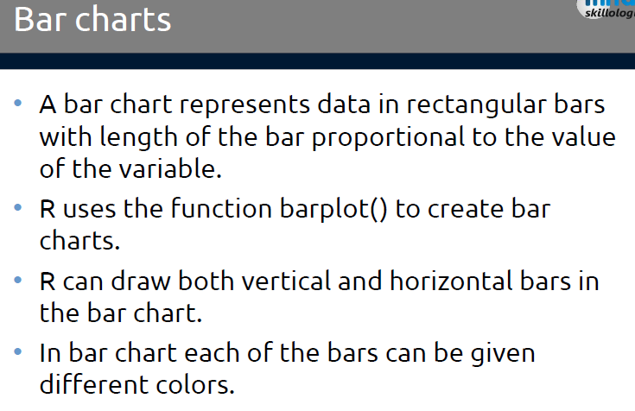

Slide 72
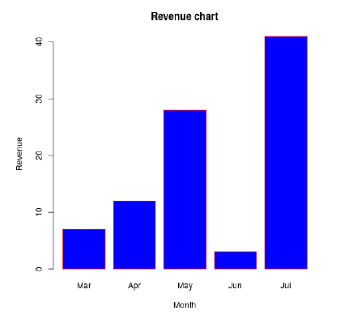
Bar Chart with Color with attributes
# Create the data for the chart.
H <- c(7,12,28,3,41)
M <- c("Mar","Apr","May","Jun","Jul")
# Give the chart file a name.
png(file = "barchart_months_revenue.png")
# Plot the bar chart.
barplot(H,names.arg = M,xlab = "Month",ylab =
"Revenue",col = "blue", main = "Revenue chart",border
= "red")
dev.off()

Slide 73
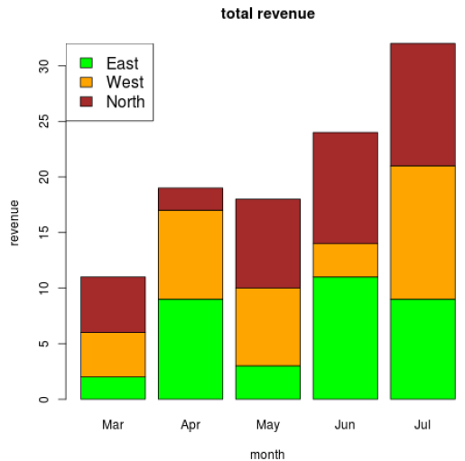
Bar chart – Stacked
colors <- c("green","orange","brown")
months <- c("Mar","Apr","May","Jun","Jul")
regions <- c("East","West","North")
Values <- matrix(c(2,9,3,11,9,4,8,7,3,12,5,2,8,10,11),nrow =
3,ncol = 5,byrow = TRUE)
png(file = "barchart_stacked.png")
barplot(Values,main = "total revenue",names.arg = months,xlab =
"month",ylab = "revenue", col = colors)
legend("topleft", regions, cex = 1.3, fill = colors)
dev.off()

Slide 74
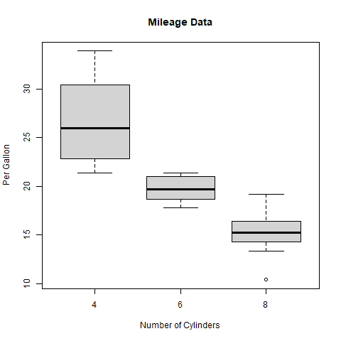
Box Plot Graphs
# Give the chart file a name.
png(file = "boxplot.png")
# Plot the chart.
boxplot(mpg ~ cyl, data = mtcars, xlab =
"Number of Cylinders", ylab = "Miles
Per Gallon", main = "Mileage Data")
# Save the file.
dev.off()

Slide 75
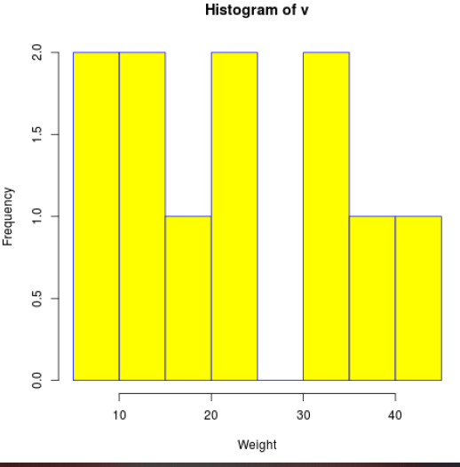
Histogram – Example
# Create data for the graph.
v <- c(9,13,21,8,36,22,12,41,31,33,19)
# Give the chart file a name.
png(file = "histogram.png")
# Create the histogram.
hist(v,xlab = "Weight",col = "yellow",border = "blue")
# Save the file.
dev.off()

Slide 76
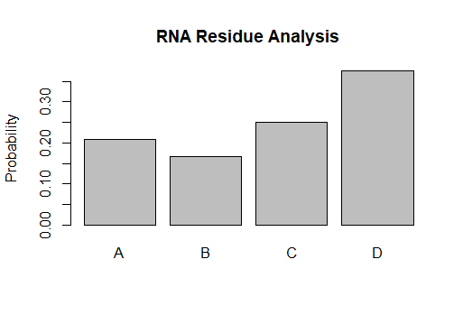
barplot
X<-c(0,1,2,3)
Prob<-c(0.208,0.167,0.25,0.375)
N<-c('A','B','C','D')
barplot(Prob,names=N,ylab="Probability", main="RNA Residue Analysis")

Slide 77


